Slide 1

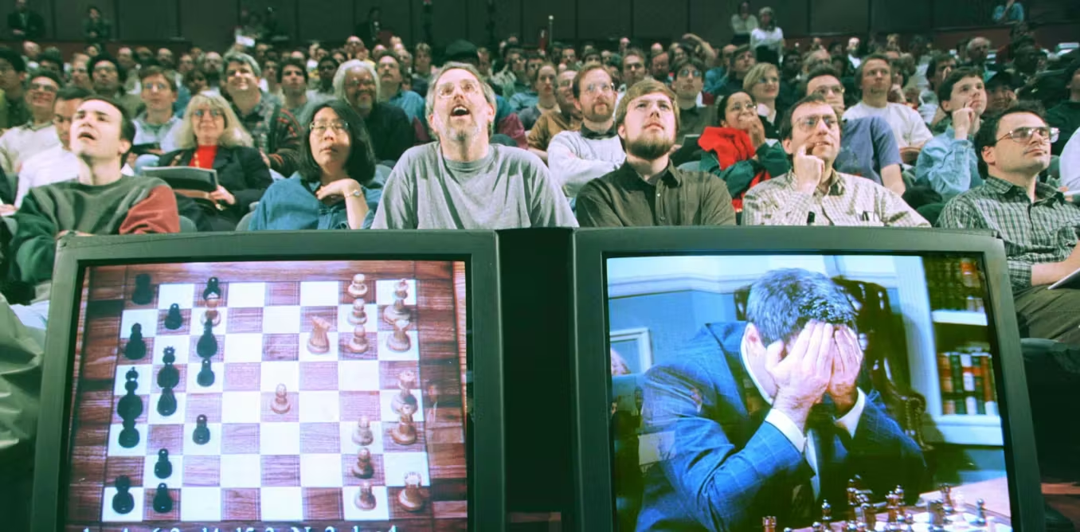

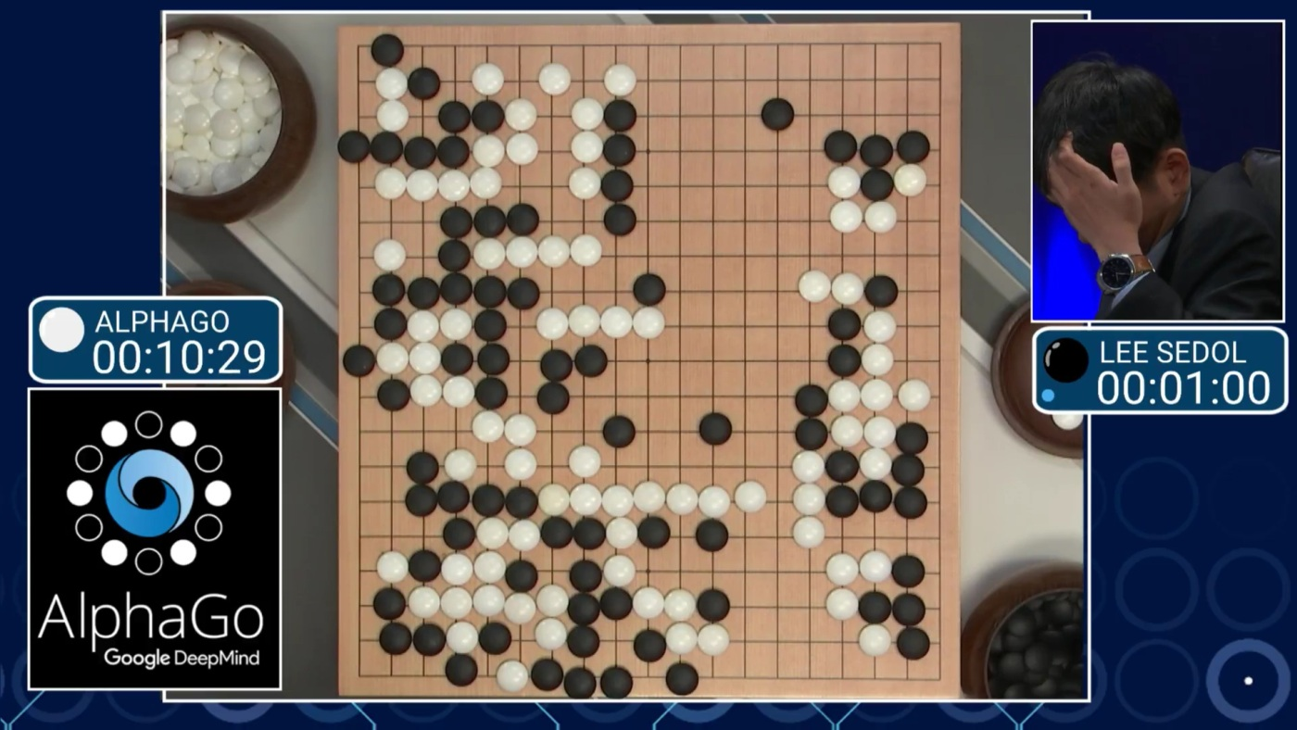

Slide 2
What will you learn?
What is AI and where do LLMs fit in the AI landscape
Basic intuition of LLMs work
Common pitfalls of using LLMs and why they happen

Slide 3
How will you learn this?
LLM model architecture
Common steps of training a basic LLM
Generating useful outputs from a trained LLM
Let’s build an LLM from scratch!
Common pitfalls of using LLMs

Slide 4


Slide 5


Slide 6
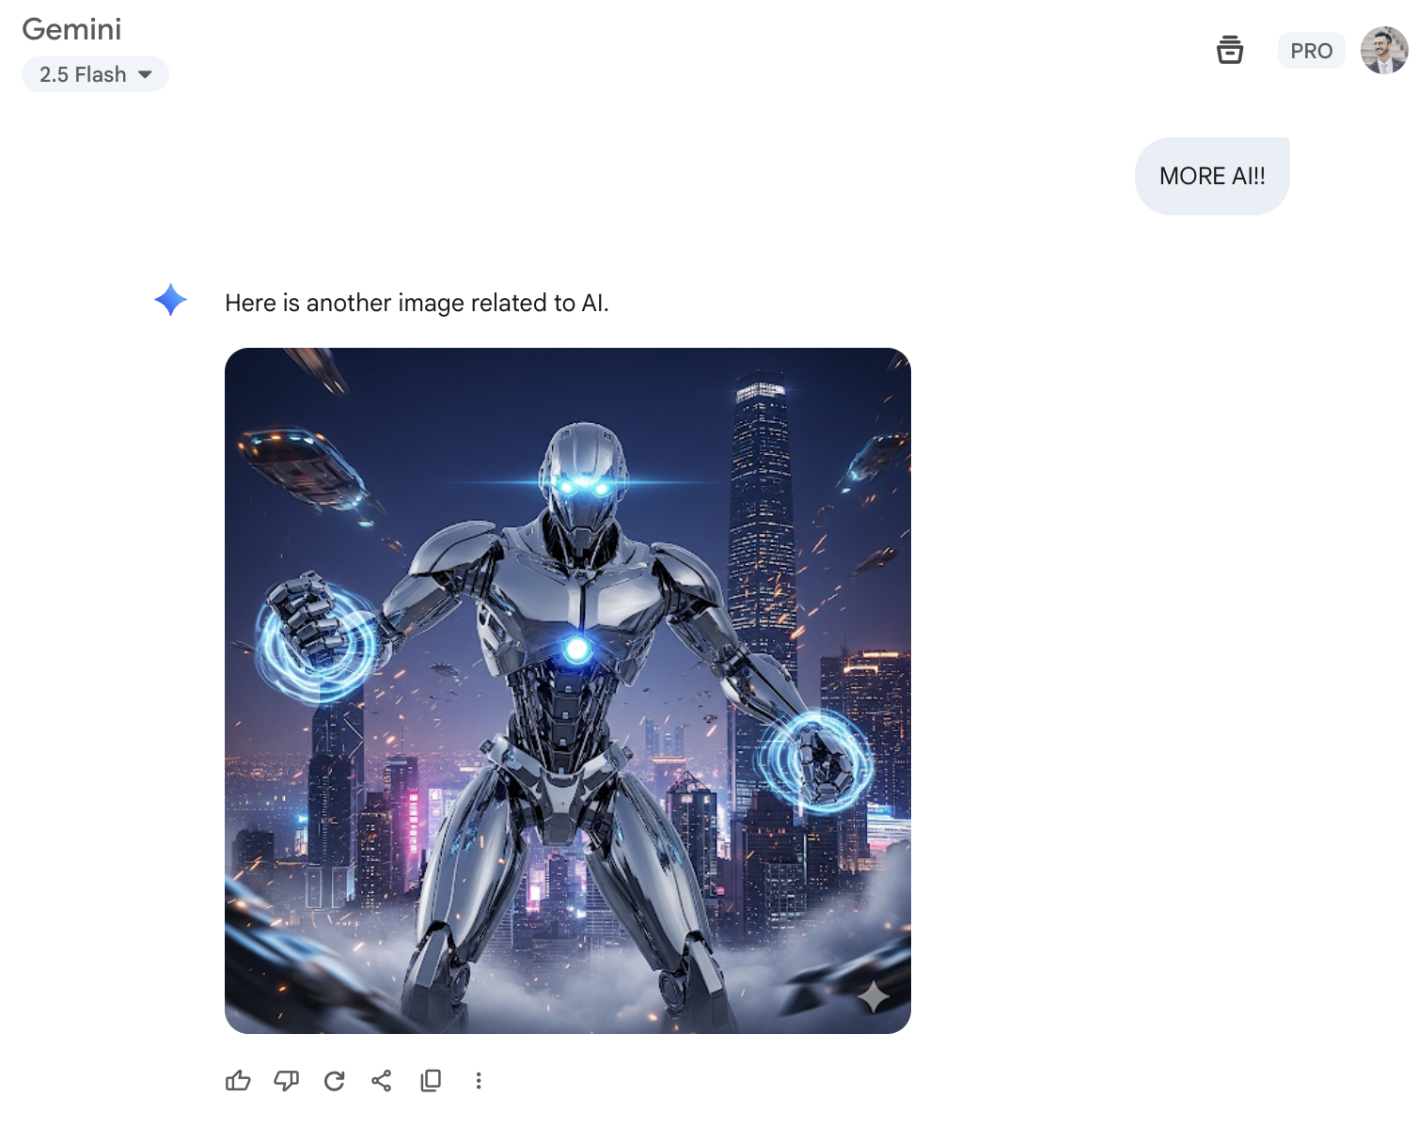
Notes:
This is what life would look like if you all just listen to Mari and restart your PCs every week
What have we learnt from this: ai is dark background, and lots of dark blue and purple

Slide 7
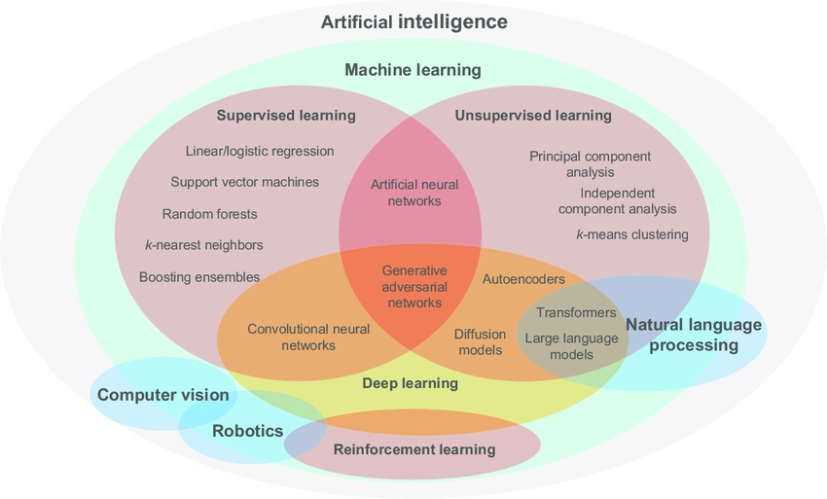

Slide 8
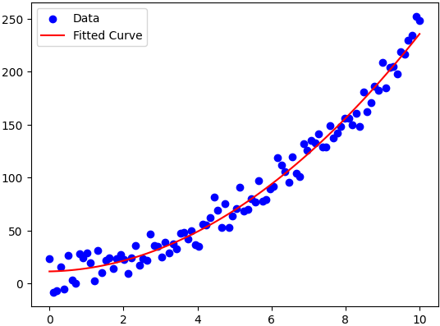
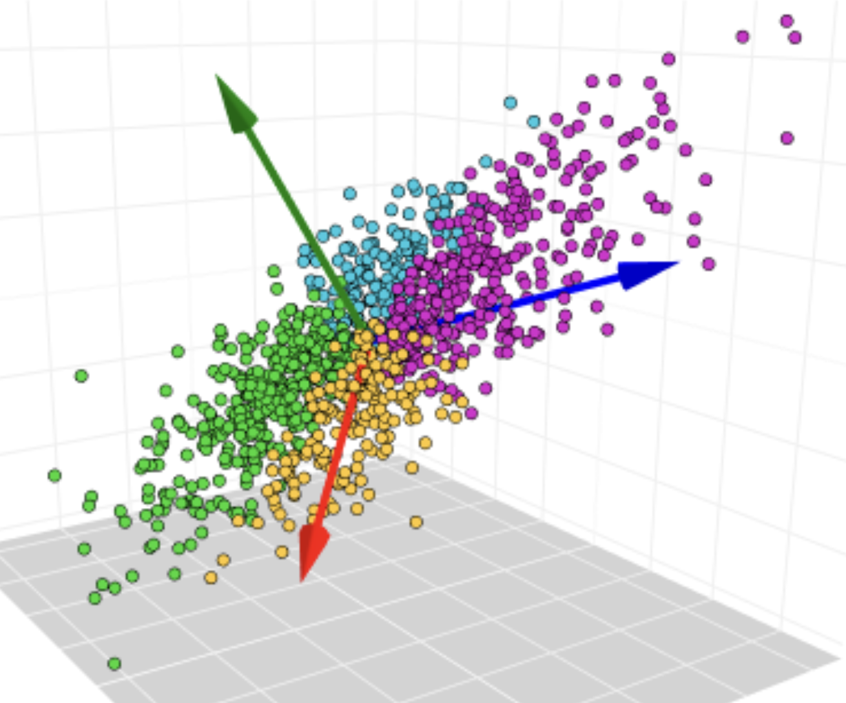
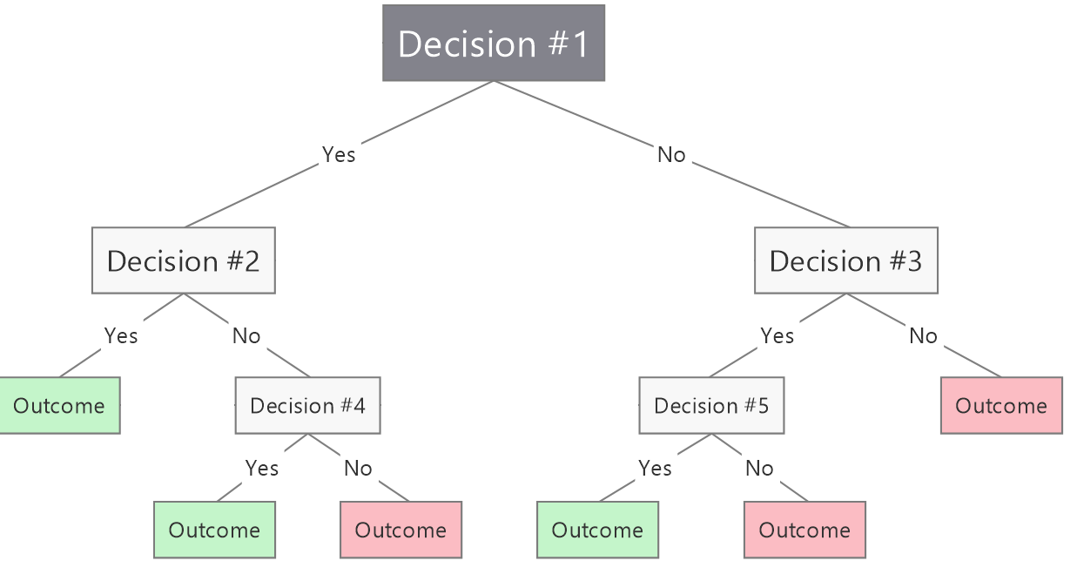
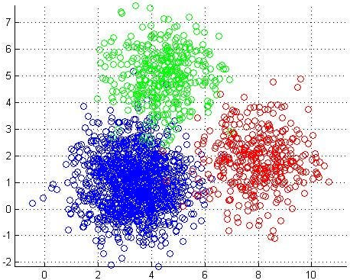
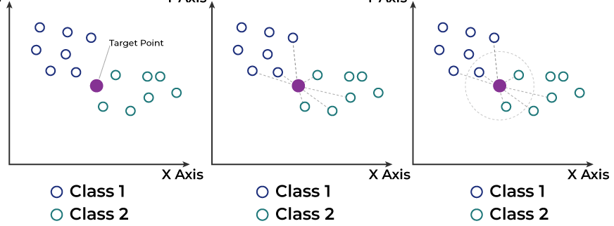

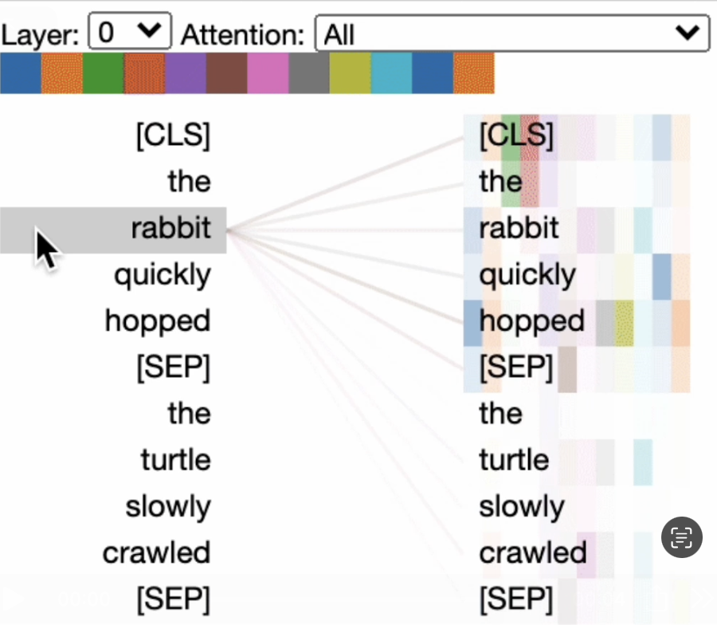
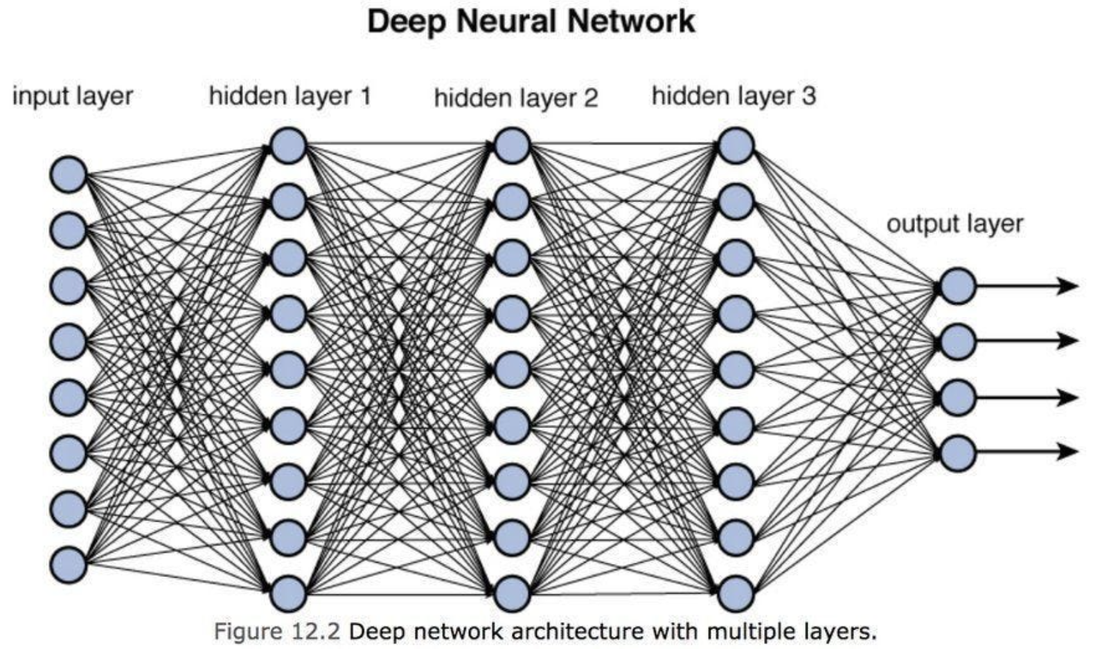
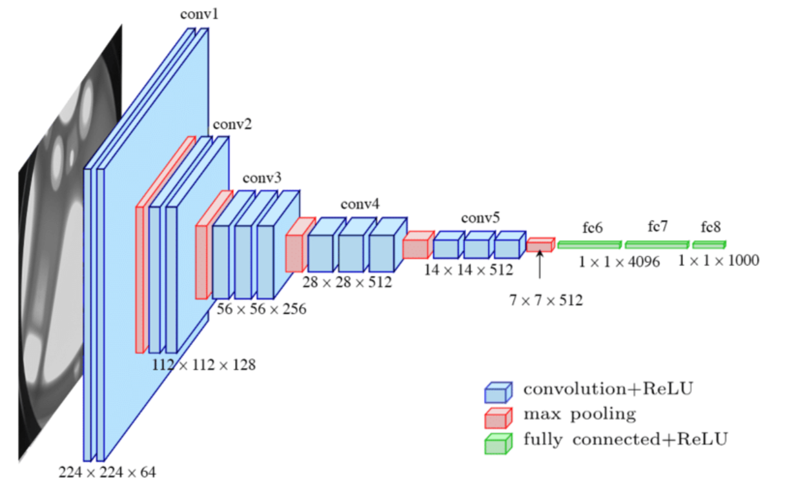
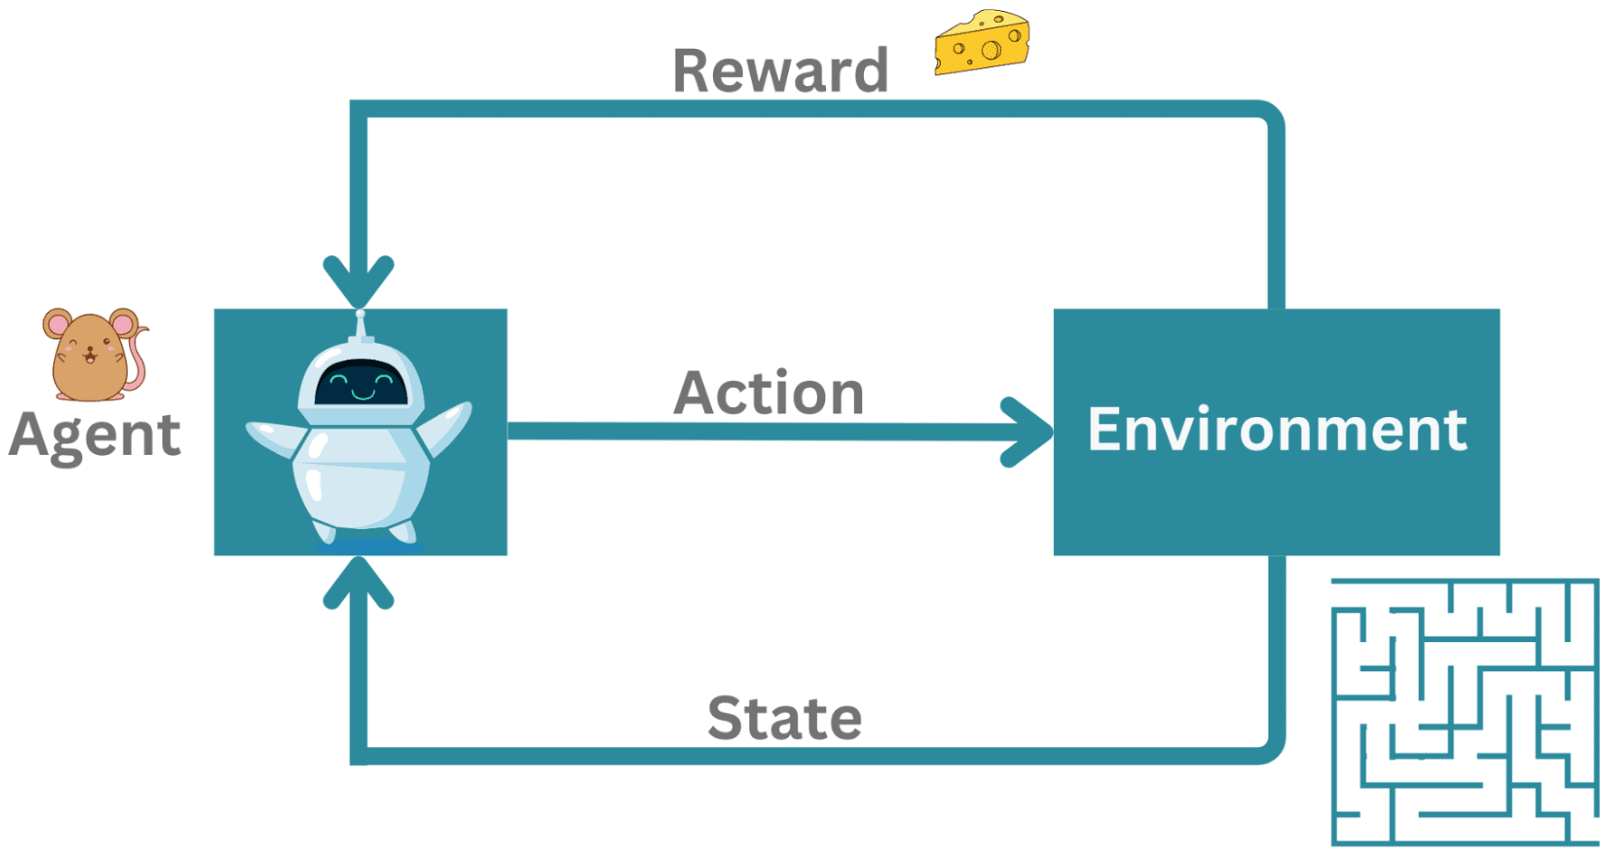

Slide 9
LLM model architecture
Common steps of training a basic LLM
Generating useful outputs from a trained LLM
Let’s build an LLM from scratch!
Common pitfalls of using LLMs

Slide 10
1. LLM model architecture
a

Slide 11
How will you learn this?
LLM model architecture
Common steps of training a basic LLM
Generating useful outputs from a trained LLM
Let’s build an LLM from scratch!
Common pitfalls of using LLMs

Slide 12
2. Common steps of training a basic LLM
Tokenization

Slide 13
2. Common steps of training a basic LLM
Pre-training

Slide 14
2. Common steps of training a basic LLM
Post-training

Slide 15
How will you learn this?
LLM model architecture
Common steps of training a basic LLM
Generating useful outputs from a trained LLM
Let’s build an LLM from scratch!
Common pitfalls of using LLMs

Slide 16
3. Generating useful outputs from a trained LLM

Slide 17
How will you learn this?
LLM model architecture
Common steps of training a basic LLM
Generating useful outputs from a trained LLM
Let’s build an LLM from scratch!
Common pitfalls of using LLMs

Slide 18
4. Let’s build an LLM from scratch!
Tokenization
Pre-training
Post-training
Generating responses

Slide 19
How will you learn this?
LLM model architecture
Common steps of training a basic LLM
Generating useful outputs from a trained LLM
Let’s build an LLM from scratch!
Common pitfalls of using LLMs

Slide 20
5. Common pitfalls of using LLMs
Which of these should LLMs be Good vs Not Good at?

Slide 21
Summary

Slide 23



